Slide 1

HySTA-NET : A HYBRID SPATIO-TEMPORAL ATTENTION NETWORK FOR RECOGNITION OF EMERGENCY SIGNS IN INDIAN SIGN LANGUAGE
Department Of Computer Science And Engineering,
TKM COLLEGE OF ENGINEERING, KOLLAM
GROUP 6
AISHA THAMEEM - TKM21CS012
BHAGYA A JAI - TKM21CS041
FATHIMA A - TKM21CS053
UTHARA SABU - TKM21CS138
Project Guide : Dr. Shyna A
Date: 09/04/2025

Slide 2
CONTENTS
INTRODUCTION
MOTIVATION
OBJECTIVES
LITERATURE REVIEW
RESEARCH GAP
METHODOLOGY
RESULT ANALYSIS AND DISCUSSION
CONCLUSION
FUTURE SCOPE
CONTRIBUTION
PUBLICATIONS
REFERENCES

Slide 3
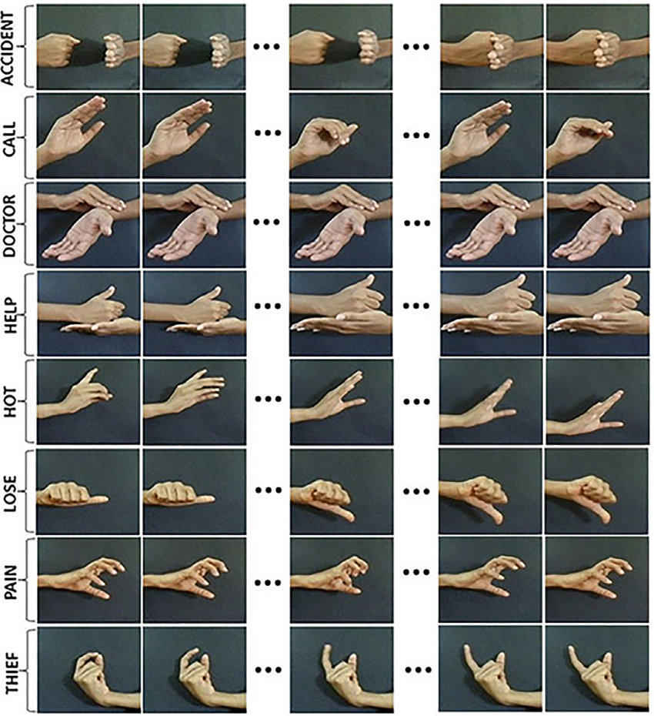
INTRODUCTION
Over 466 million people globally live with hearing loss.
Many rely on sign language as their primary means of communication.
Indian Sign Language (ISL) is widely used in India.
Current recognition systems, especially for emergency gestures, are underdeveloped.
In emergencies, failure to convey distress signals can delay help and risk lives.
Most systems focus on general vocabulary, not emergency-specific gestures.

Slide 4
MOTIVATION
Communication Gaps : Deaf individuals struggle to convey emergencies due to the lack of widespread ISL awareness.
Delayed Assistance : Unrecognized ISL gestures in emergency situations can lead to life-threatening delays.
Lack of Specialized Systems : Existing recognition models fail to address emergency-specific gestures.
Technical Barriers : Real-time gesture recognition is challenging due to individual and environmental variations.

Slide 5
OBJECTIVES
.
Develop an Algorithm for Real-Time Emergency Gesture Recognition
Ensure Effective Emergency Communication
Analyze Emergency Gesture Videos for Gesture Variations
Implement Key Frame Extraction for Improved Performance

Slide 6
LITERATURE REVIEW
Sl. No | Name of Author(s) | Work Done | Highlights/Inference
1 | Rao et al. (2018)[1] | Neural network classifier for continuous sign language identification | Used selfies for sign recognition, but lacked effective temporal modeling
2 | Do et al. (2020)[2] | Multi-level feature LSTM network for dynamic gesture recognition | Achieved 96.07% and 94.40% accuracy for 14 and 28-class problems, but faced challenges with limited datasets
3 | Cui et al. (2017)[3] | Video-based recurrent CNN for continuous sign recognition | Improved temporal modeling but struggled with dataset limitations
4 | Elboushaki et al. (2020)[4] | Combined Residual Networks (ResNets) with ConvLSTM | Captured spatio-temporal dependencies, but computational complexity remained high
.

Slide 7
LITERATURE REVIEW
Sl. No | Name of Author(s) | Work Done | Highlights/Inference
5 | Liao et al. (2019)[5] | Proposed B3D ResNet (3D Residual ConvNet + Bi-directional LSTM) | Effectively handled complex gestures but suffered from high computational demands
6 | John et al. (2016)[6] | Frame extraction techniques for LRCN | Improved performance by extracting key frames (SMRF Algorithm), enhancing dynamic gesture recognition and achieved a classification accuracy of 95%.
7 | Khari et al. (2019)[7] | Used VGG-19 for static ASL recognition | Achieved 94.8% accuracy but ineffective for dynamic gestures.
8 | Qazi Mohammad Areeb et al. (2022)[8] | Used VGG-16 for spatial feature extraction + LSTM for temporal modeling | Designed to improve ISL emergency sign recognition by capturing both spatial and temporal features effectively
.

Slide 8
RESEARCH GAP
Static gesture methods lack robust temporal modeling for dynamic gestures.
Small, limited datasets hinder generalization.
High computational cost in 3D CNNs limits real-time deployment.
Long-term temporal dependencies are not effectively captured.
Reliance on additional sensor data reduces practical applicability.
Underexplored integration of multi-head attention for spatio-temporal enhancement.

Slide 9
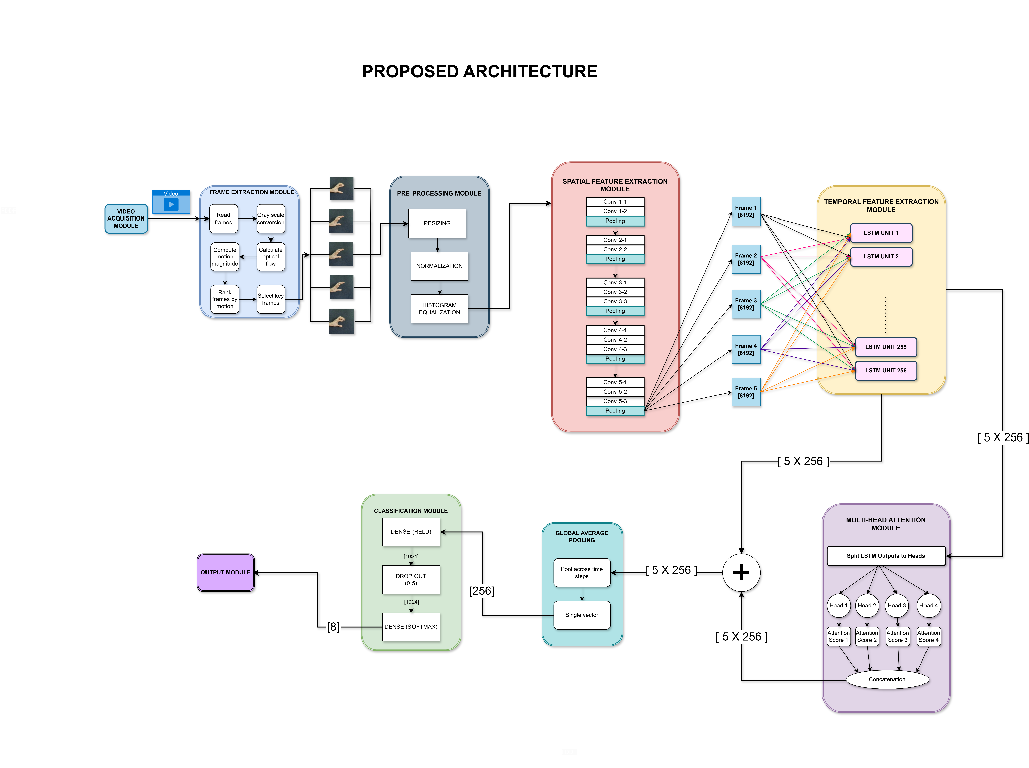
METHODOLOGY
Proposed System Architecture of HySTA-Net

Slide 10
METHODOLOGY
1. Video Acquisition Module
Responsible for providing raw video data to the Frame Extraction Module.
412 video samples representing 8 emergency ISL sign classes are collected and stored in a structured directory.
Ensures reliable access, proper organization, and readiness of video data for preprocessing.
Serves as the foundation for effective frame extraction and feature analysis.

Slide 11
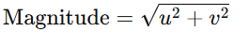
METHODOLOGY
2. Frame Extraction Module
Various Frame Extraction methods were evaluated, including uniform sampling, random selection, and motion-based approaches. Through experimentation, the hybrid optical flow method emerged as the most effective.
The algorithm for Key Frame Selection in the Frame Extraction Module is outlined below:
Input: A dynamic video sequence containing emergency sign language gestures. Output: A curated set of frames that effectively represents the gesture, ready for preprocessing.
Algorithm Overview:
Motion Quantification
Compute optical flow between consecutive frames.
Calculate motion magnitude: where u and v are the horizontal and vertical flow components,.

Slide 12
METHODOLOGY
2. Frame Extraction Module
2. Key Frame Selection
Select frames with highest motion peaks, ensuring the first and last frames are included.
If fewer frames are selected than required, supplement with uniformly sampled frames.

Slide 13
METHODOLOGY
3. Pre-Processing Module
Objective: Standardize and enhance frames for optimal VGG-16 spatial-temporal analysis.
Resizing: Convert all frames to a fixed size (e.g., 150×150 pixels) for uniformity.
Normalization: Scale pixel intensities to [0,1] to harmonize data and stabilize model training.
Histogram Equalization: Enhance contrast to highlight subtle gesture features.
Consistent Format: Ensure pre-processed frames are ready for accurate feature extraction by VGG-16.

Slide 14
METHODOLOGY
4. Spatial Feature Extraction Module
Four models were evaluated for spatial feature extraction in Hysta-Net: 3D-CNN, Inception V3, ResNet50, and VGG-16.
VGG-16 was chosen due to its superior performance, providing better feature extraction results compared to the others.
VGG-16 Architecture:
VGG-16 uses a deep stack of 3×3 convolutional filters to capture fine-grained spatial details.
The fully connected layers are removed, and the convolutional base is frozen to minimize overfitting.
VGG-16 extracts spatial feature maps that capture edges, textures, and complex structures inherent in the gesture images.

Slide 15
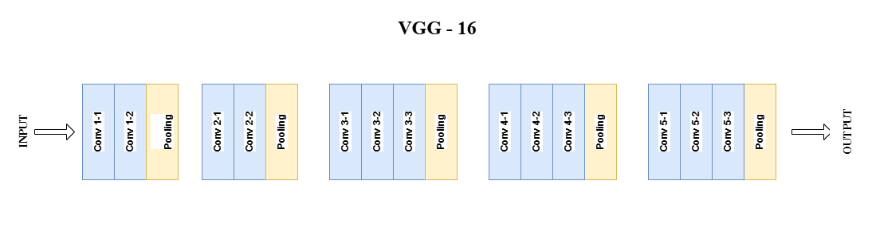
METHODOLOGY
Figure: VGG-16 Architecture

Slide 16
METHODOLOGY
4. Spatial Feature Extraction Module
Feature Representation:
The extracted features are represented as vectors each with a dimension of 8192.
These feature vectors are fed into the Temporal Feature Extraction Module for further dynamic analysis.

Slide 17
METHODOLOGY
5. Temporal Feature Extraction Module
Objective: Capture the dynamic evolution of sign language gestures, which static features alone cannot represent.
Model: Use a Long Short-Term Memory (LSTM) network with 256 hidden units.
Process: For each spatial feature vector x_{t​} (from the VGG-16 module), the LSTM computes
h_{t}= LSTM (x_{t}, h_{t−1}), capturing both short-term transitions and long-term dependencies.
Output: Produces a sequence of hidden states h_{1​},h_{2​},…,h_{T​} that encapsulate the gesture's temporal progression.
Enhancements: Further mechanisms like multi-head attention can be applied later to emphasize the most salient temporal cues.

Slide 18
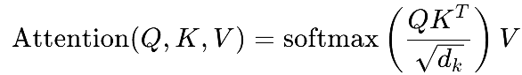
METHODOLOGY
6. Multi-Head Attention Module
Enhances temporal features obtained from the LSTM by capturing diverse aspects of motion and context.
Splits the LSTM output into multiple subspaces and computes scaled dot-product attention for each head using: where Q, K, and V are linear projections of the LSTM output.
Uses four parallel attention heads; their outputs are concatenated and linearly transformed with an output projection matrix W_{O}​ resulting in a richer representation.
Output is forwarded to subsequent processing stages

Slide 19
METHODOLOGY
7. Residual Connection
Purpose: Preserve original temporal features from LSTM while incorporating enhanced features from multi-head attention.
Need for Residual Connection:
Retains essential sequential information for dynamic gesture recognition.
Prevents issues like vanishing gradients.
Ensures vital temporal dynamics are not lost.

Slide 20
METHODOLOGY
7. Residual Connection
Implementation:
Residual Addition: Element-wise addition of LSTM output and multi-head attention output.
Formula: X_{res} = X_{LSTM} + X_{attn}
Outcome:
Combines original and refined features, boosting the model's ability to recognize dynamic emergency gestures.

Slide 21
METHODOLOGY
8. Global Average Pooling
Purpose: Aggregates temporal features into a fixed-length vector, summarizing the essential information for classification.
Significance:
Reduces spatial-temporal feature map to a concise representation.
Minimizes the number of parameters, helping mitigate overfitting.
Retains the most important features for accurate gesture recognition.

Slide 22
METHODOLOGY
9. Classification Module
Purpose: Converts the pooled feature vector into a probability distribution over the sign classes.
Dense Layer with ReLU Activation:
Transforms the feature vector into a higher-dimensional space.
Non-linearity is introduced via ReLU: h = ReLU(W₁z + b₁)
Dropout Layer:
Applied with a 0.5 rate to prevent overfitting.
Randomly deactivates 50% of neurons during training.

Slide 23
METHODOLOGY
9. Classification Module
Dense Layer with Softmax Activation: Produces the final probability distribution over the classes:
y= softmax(W₂h + b₂)
Outcome: Transforms refined features into predictions indicating the likelihood of each emergency sign.

Slide 24
METHODOLOGY
10. Output Module
Purpose: Captures the final predictions of the system.
Softmax Output: The softmax output vector y represents the probability distribution over predefined sign classes, with the class having the highest probability selected as the final predicted sign.

Slide 25
METHODOLOGY
11. Custom Models created as part of Methodology
Different spatial feature extraction modules were incorporated into HySTA-Net to evaluate and compare performance. These include HySTA-Net with 3DCNN, InceptionV3 and ResNet50.
Among these, HySTA-Net using VGG16 as the spatial feature extractor demonstrated the best performance in both train-test splits and evaluations on custom video datasets.
The detailed architectures of the custom models are presented in the following slides.

Slide 26
METHODOLOGY
11. Custom Models created as part of Methodology
1. HySTA-Net with 3DCNN
3D CNN as Feature Extractor:
The model integrates 3D CNN to capture both spatial details and temporal dynamics from input video sequences.
3D convolutions analyze patterns across multiple frames, enabling the model to effectively extract features from gesture movements.
Multi-Head Attention: The multi-head attention mechanism is used to refine the temporal features by focusing on the most relevant parts of the sequence. This enhances the model's ability to recognize complex gesture patterns.

Slide 27
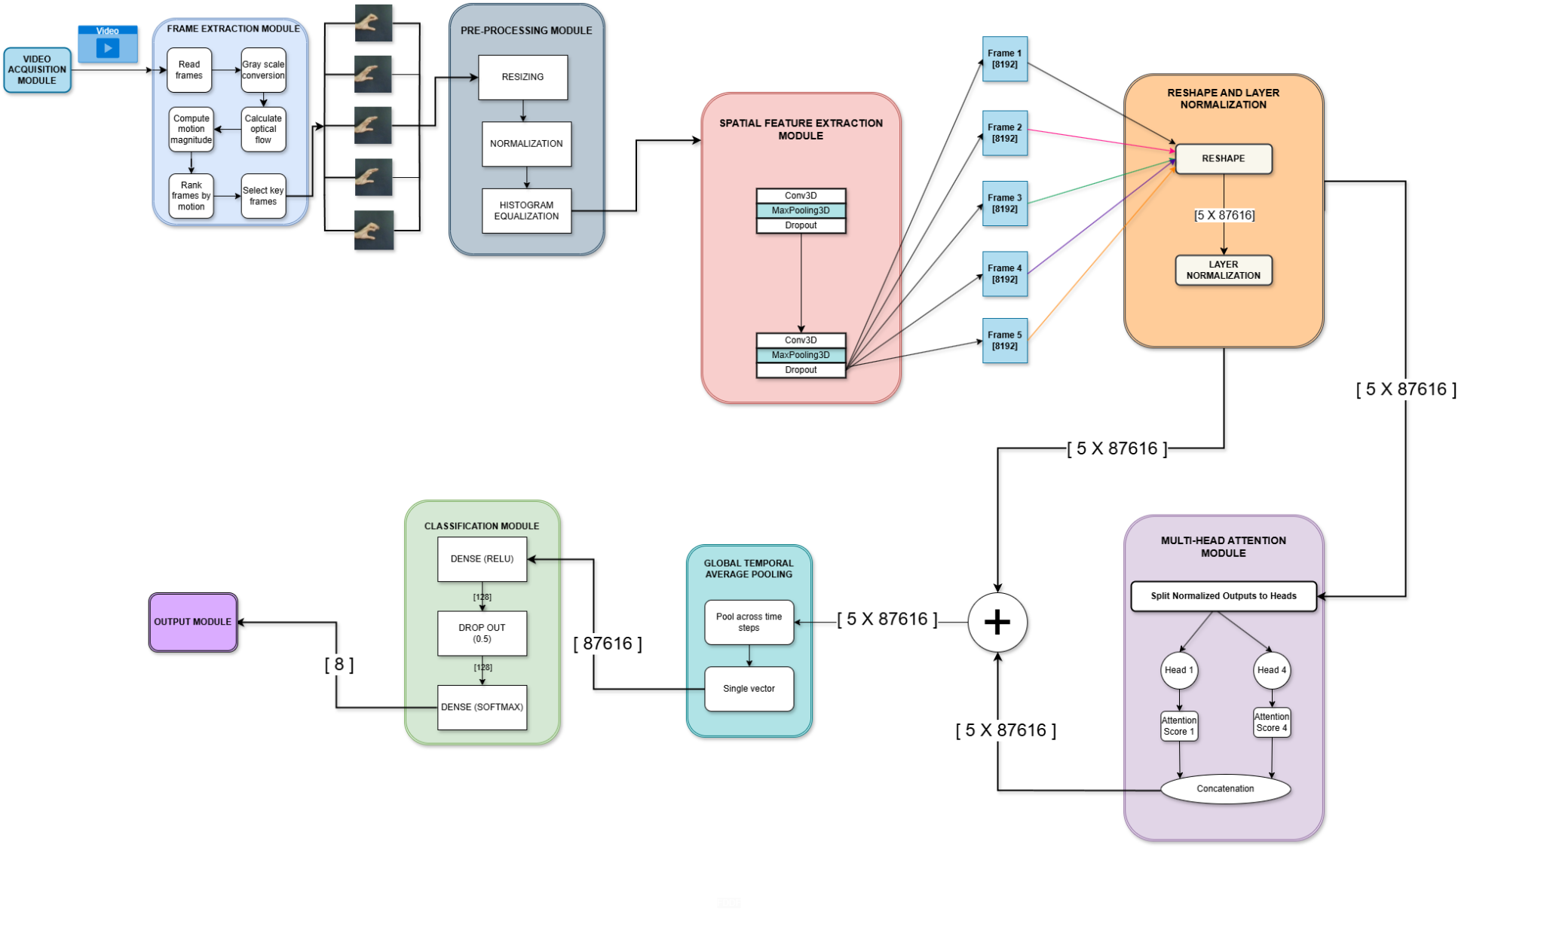
Architecture Diagram of HySTA-Net using 3DCNN

Slide 28
METHODOLOGY
11. Custom Models created as part of Methodology
2. HySTA-Net with InceptionV3
InceptionV3 as Spatial Feature Extractor:
InceptionV3 is utilized for spatial feature extraction due to its efficient architecture, which uses multiple filter sizes within the same layer to capture spatial features at various scales.
Multi-Head Attention: Refines temporal features by focusing on different sequence parts simultaneously.
The combination of InceptionV3, LSTM, and multi-head attention enhances the model's performance in recognizing complex gesture movements.

Slide 29
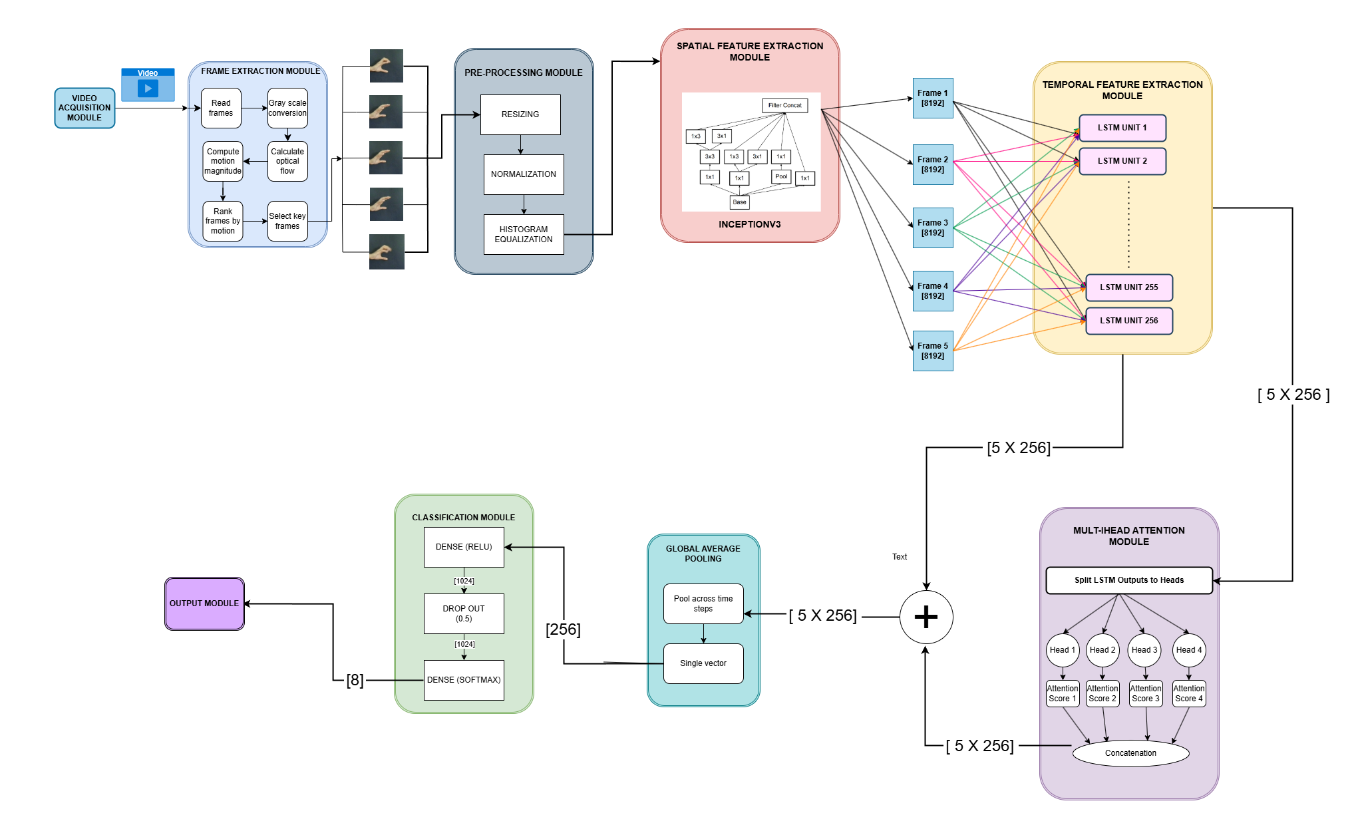
Architecture Diagram of HySTA-Net using InceptionV3

Slide 30
METHODOLOGY
11. Custom Models created as part of Methodology
3. HySTA-Net with ResNet50
ResNet50 for Spatial Feature Extraction: Utilizes deep residual learning to enable efficient gradient propagation, improving the extraction of complex spatial features from input gestures.
Self-Attention Mechanism: This architecture utilizes a self-attention mechanism rather than a multi-head attention mechanism, as it demonstrated superior performance in terms of accuracy.
Self-attention allows the model to focus on the most relevant parts of the input sequence for better feature refinement.

Slide 31
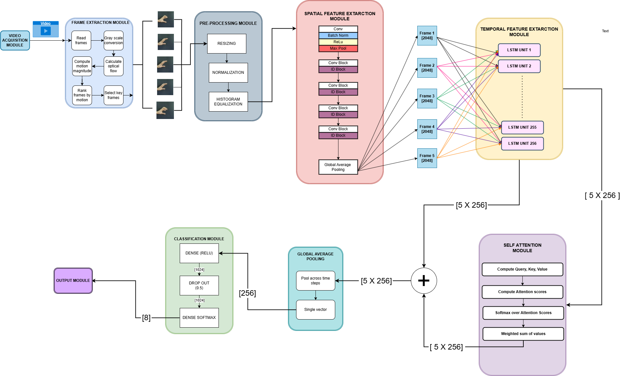
Architecture Diagram of HySTA-Net using ResNet50

Slide 32
RESULT ANALYSIS AND DISCUSSION
1. DATASET
Publicly Available Dataset
Utilizes a video-based ISL dataset with 412 videos.
Focuses on emergency ISL gestures for critical communication.
Includes 8 gestures: accident, call, doctor, help, hot, lose, pain, thief.
50 videos per gesture on average.
26 participants (12 males, 14 females), aged 22-26 years.
Supports vision-based sign language recognition research.
Class Label | Sign | Number of Videos
0 | Accident | 52
1 | Call | 52
2 | Doctor | 52
3 | Help | 52
4 | Hot | 52
5 | Lose | 50
6 | Pain | 52
7 | Thief | 50
 | Total | 412

Slide 33
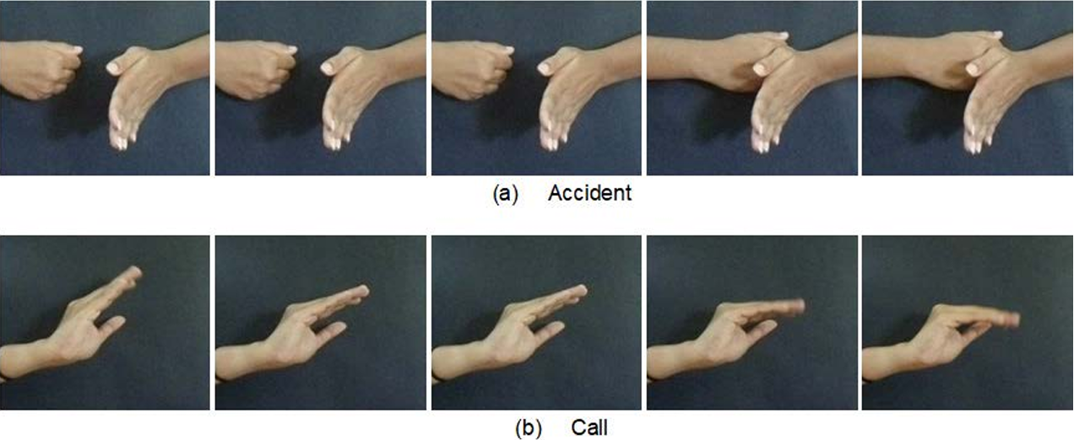
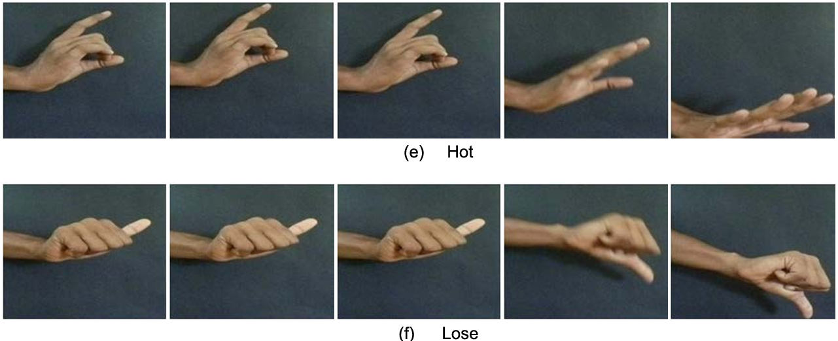
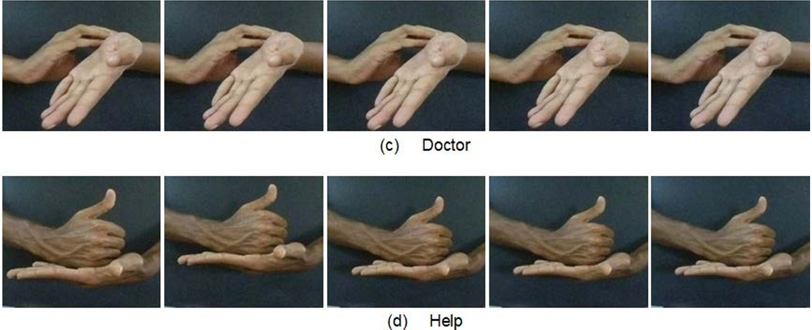
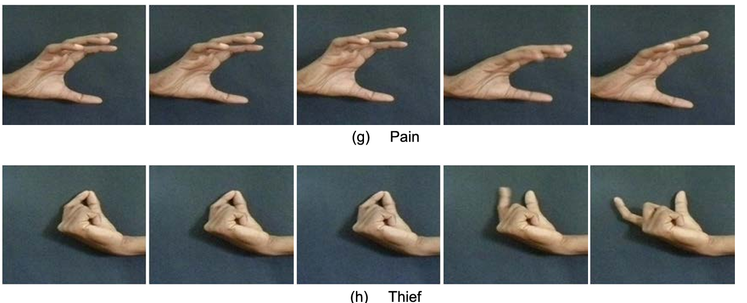
RESULT ANALYSIS AND DISCUSSION
1. DATASET
Publicly Available Dataset

Slide 34
RESULT ANALYSIS AND DISCUSSION
1. DATASET
Custom Dataset
Includes 8 different ISL signs: Call, Doctor, Help, Hot, Lose, Pain, Thief, and Total.
A total of 50 videos recorded.
Variations Captured:
Hand orientation, speed, and lighting conditions are varied to mimic real-world scenarios
Diversity in hand shapes and movement styles contributed by 7 different signers.
Purpose: Designed to evaluate and improve the performance of the proposed ISL recognition model.

Slide 35
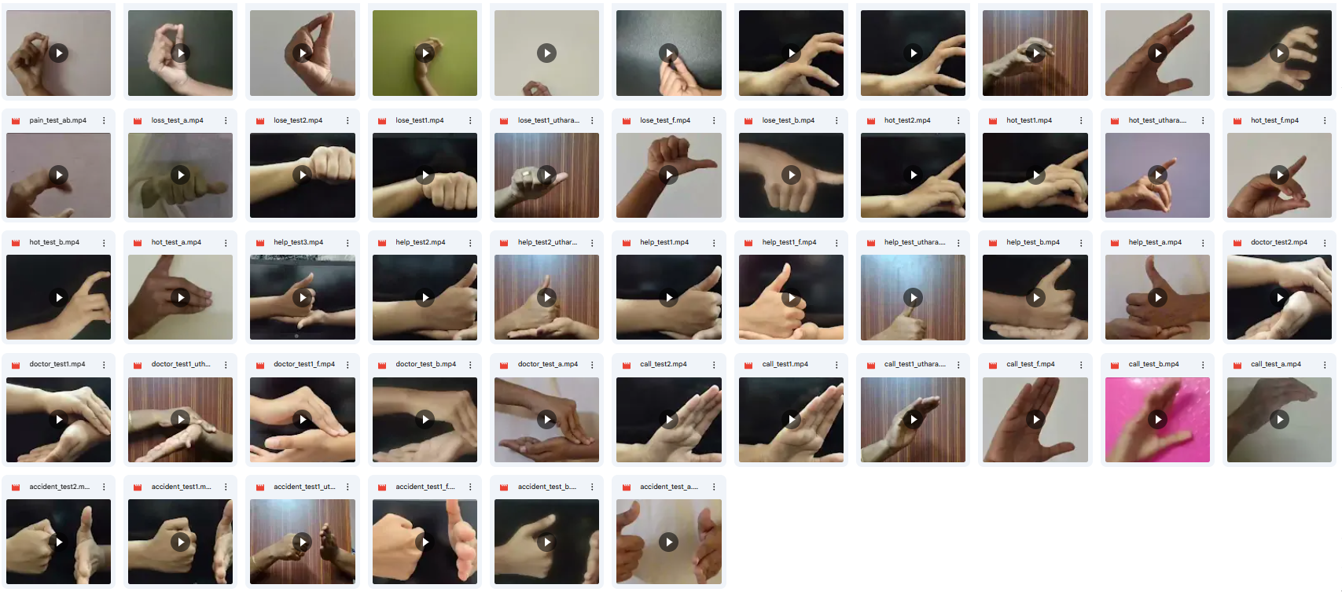
RESULT ANALYSIS AND DISCUSSION
1. DATASET
Custom Dataset

Slide 36
RESULT ANALYSIS AND DISCUSSION
2. KEY FRAME EXTRACTION ANALYSIS
Evaluated multiple methods: High Entropy, Structural Similarity Index (SSIM), Gradient-Based, and Optical Flow.
Goal: Capture key gesture transitions while reducing redundancy.
Optical Flow Method performed best, isolating meaningful transitions.
Achieved higher accuracy and generalization in recognition.
Outperformed other methods in precision, recall, and F1-score.
Chosen as the optimal method for dynamic sign recognition.

Slide 37
RESULT ANALYSIS AND DISCUSSION
2. KEY FRAME EXTRACTION ANALYSIS
Key Frame Extraction Method | Custom test accuracy | Model Accuracy (%) | Precision (%) | Recall (%) | F1-Score (%)
Random Frame Selection | 46 | 82.45 | 83.12 | 81.20 | 82.15
High Entropy Method | 73 | 89.32 | 90.15 | 88.75 | 89.44
SSIM (Structural Similarity) | 76 | 92.18 | 93.05 | 91.50 | 92.27
Gradient-Based Method | 82 | 95.1 | 95.68 | 94.85 | 95.26
Optical Flow Method | 96 | 100 | 100 | 100 | 100

Slide 38
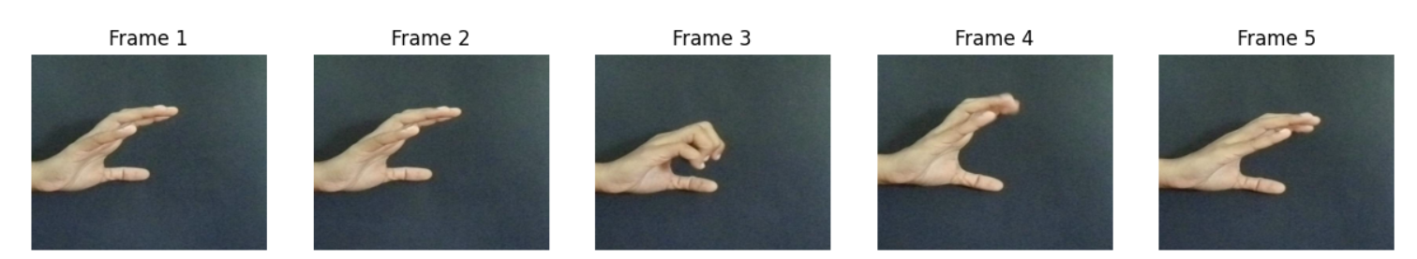
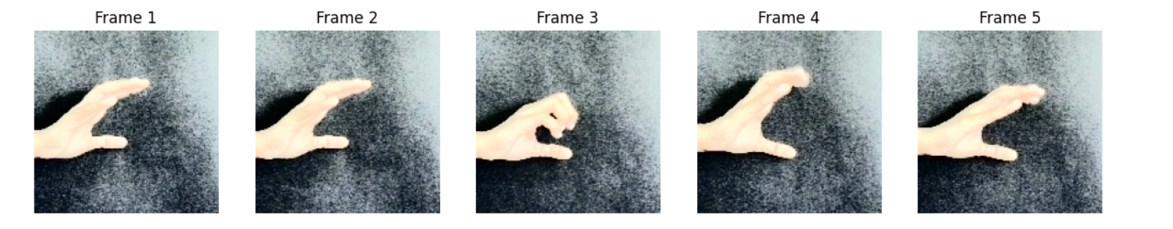
RESULT ANALYSIS AND DISCUSSION
3. PRE-PROCESSING TECHNIQUES ANALYSIS
Resizing to 150×150 pixels for uniform input dimensions.
Normalization to scale pixel values, improving model convergence.
Histogram equalization to enhance contrast and highlight gesture details.
No Gaussian blur, noise reduction, or data augmentation to preserve natural gesture features.
Ensured critical details remain intact for accurate recognition.
Figure : Input Frames of a sign gesture video
Figure: Output Frames of a sign gesture video after resizing, normalization and histogram equalisation

Slide 39
RESULT ANALYSIS AND DISCUSSION
4. PERFORMANCE EVALUATION OF HySTA-NET
Performance of Baseline Models on the ISL Emergency Gesture Dataset
Model | Precision (%) | Recall (%) | F1-Score (%) | Test Accuracy (%)
VGG16 + LSTM (Existing paper, 2022) | 97.5 | 97.75 | 97.38 | 98
3D CNN (Existing paper, 2022) | 85.0 | 83.63 | 82.63 | 82

Slide 40
RESULT ANALYSIS AND DISCUSSION
4. PERFORMANCE EVALUATION OF HySTA-NET
Models without Attention Mechanism
Model | Precision (%) | Recall (%) | F1-Score (%) | Test Accuracy (%) | Custom Test Accuracy (50 videos) (%)
HySTA-Net using VGG16 | 99 | 98 | 98.8 | 98.8 | 88
HySTA-Net using ResNet50 | 96.90 | 96.39 | 96.38 | 96.39 | 65.79
HySTA-Net using InceptionV3 | 96 | 95 | 95 | 95 | 36
HySTA-Net using 3D CNN | 86 | 84 | 84.34 | 84.34 | 18.37

Slide 41
RESULT ANALYSIS AND DISCUSSION
4. PERFORMANCE EVALUATION OF HySTA-NET
Models with Attention Mechanism
Model | Precision (%) | Recall (%) | F1-Score (%) | Test Accuracy (%) | Custom Test Accuracy (50 videos) (%)
HySTA-Net using VGG16(Multi-Head Attention) | 100 | 100 | 100 | 100 | 96
HySTA-Net using VGG16(Single-Head Attention) | 100 | 100 | 100 | 100 | 88
HySTA-Net using ResNet50 (Single-Head Attention) | 97.93 | 97.59 | 97.57 | 97.59 | 55.26
HySTA-Net using InceptionV3 (Multi-Head Attention) | 96 | 95 | 95.2 | 95.2 | 50
HySTA-Net using 3D CNN (Multi-Head Attention) | 82 | 83 | 82 | 83.14 | 22.45

Slide 42
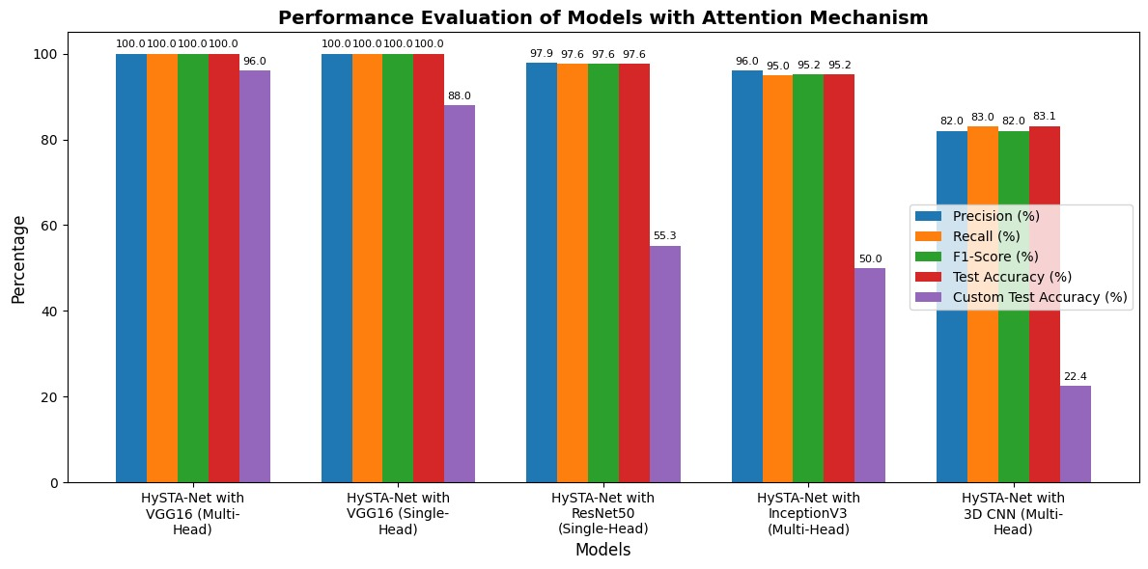
RESULT ANALYSIS AND DISCUSSION
5. Performance Comparison of HySTA-Net Variants with Attention Mechanism

Slide 43
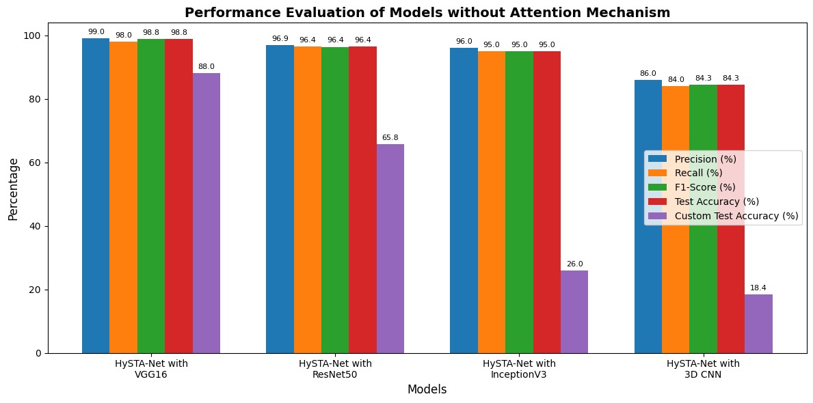
RESULT ANALYSIS AND DISCUSSION
6. Performance Comparison of HySTA-Net Variants without Attention Mechanism

Slide 44
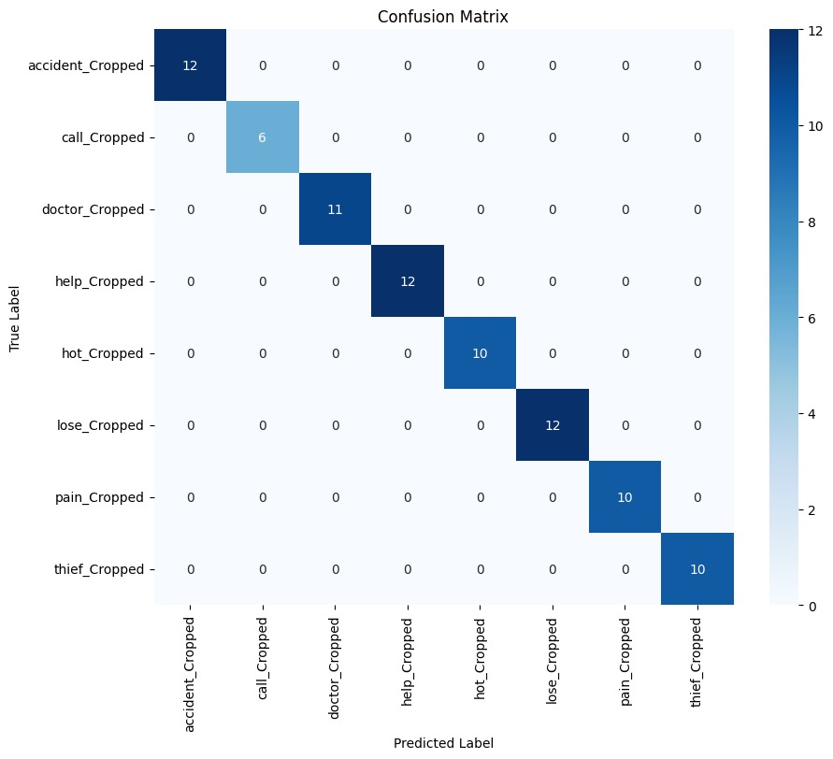
RESULT ANALYSIS AND DISCUSSION
7. Confusion Matrix of HySTA-Net using VGG-16(Multi-Head Attention)

Slide 45
PROGRAM OUTCOMES ACHIEVED
PO No. | Program Outcome Description | Achievement in Project
PO1 | Engineering Knowledge | Applied deep learning, computer vision, and other principles to ISL gesture recognition system.
PO2 | Problem Analysis | Tackled challenges like gesture variation and lighting using preprocessing and robust models.
PO3 | Design & Development of Solutions | Systematically developed solution with preprocessing, model training, keyframe extraction, and evaluation.
PO4 | Investigations of Complex Problems | Analyzed multiple architectures, keyframe methods, and attention mechanisms for optimized performance.
PO5 | Modern Tool Usage | Used Google Colab, TensorFlow, Keras, OpenCV and NumPy for deep learning, preprocessing, and keyframe analysis.
PO6 | Engineer and Society | Designed to aid hearing-impaired individuals in emergency situations, enhancing social impact.

Slide 46
PROGRAM OUTCOMES ACHIEVED
PO No. | Program Outcome Description | Achievement in Project
PO7 | Environment & Sustainability | Achieved functionality using software-only approaches on existing devices—no extra hardware.
PO8 | Ethics | Maintained data privacy, used ethically sourced datasets, and followed research integrity practices.
PO9 | Individual and Team Work | Demonstrated coordinated teamwork through task division and collaborative model development.
PO10 | Communication | Communicated work through reports, presentations, and multiple internal evaluations.
PO11 | Project Management & Finance | Effectively managed time, datasets, and system phases through planned execution.
PO12 | Life-long Learning | Explored literature, identified gaps, and updated methodologies with continuous learning and adaptation.

Slide 47
CONCLUSION
Superior Performance of HySTA-NET using VGG16 Based Architecture:
The HySTA-Net using VGG16 achieved 100% test accuracy and 96% accuracy on a custom dataset.
Comparison with Other Models:
Alternative architectures (ResNet50, 3D CNN, InceptionV3) were explored, yet VGG16 consistently outperformed them in our experiments.
Effective Use of Attention Mechanism:
Multi-head attention significantly enhanced the capture of spatial-temporal features compared to single-head approaches.
Robust Yet Room for Improvement:
Despite excellent test results, the gap with the custom dataset highlights the need for further refinement and adaptation to diverse real-world conditions.

Slide 48
FUTURE SCOPE
Dataset Expansion: Enrich the dataset with varied real-world conditions (lighting, backgrounds, sign variations) to improve generalization.
Real-Time & Edge Deployment: Optimize for real-time sign recognition and deploy on mobile/embedded devices.
Cross-Model Ensemble: Investigate ensembles combining VGG16 with architectures like ResNet50, 3D CNN, and InceptionV3 for enhanced performance.
Integration with NLP: Combine sign recognition with natural language processing for seamless sign-to-text or sign-to-speech systems.
Multi-Lingual Support: Extend the system to support multiple sign languages and dialects.

Slide 49
EXPERIMENTAL SETUP
Python 3.8 - Programming language used
Jupyter Notebook - Interactive environment for creating and sharing documents with live code, equations, and visualizations.
OpenCV- provides an optimized Computer Vision libraries, tools, hardware, and supports model execution.
Tensorflow - Software library for training and inference of deep neural networks
Sklearn (Scikit-Learn) - Software ML library that provides classic machine learning models and evaluation metrics.
Google Colab - Used for getting GPU support while training.

Slide 50
PUBLICATIONS
Malayalam Sign Language Recognition using Machine Learning Models. (Conference Communicated).
HySTA-Net : A Hybrid Spatio-Temporal Attention Network for Recognition of Emergency Signs in Indian Sign Language. (Paperwork completed).

Slide 51
CONTRIBUTION
NAME | CONTRIBUTION
Aisha Thameem | HySTA-Net using 3D CNN
Bhagya A Jai | HySTA-Net using VGG16
Fathima A | HySTA-Net using ResNet50
Uthara Sabu | HySTA-Net using InceptionV3

Slide 52
REFERENCES
[1] G. A. Rao, P. V. V. Kishore, A. S. C. S. Sastry, D. A. Kumar, and K. Kumar, ‘‘Selfie continuous sign language recognition with neural network classifier,’’ in Proceedings of 2nd International Conference on Micro-Electronics, Electromagnetics and Telecommunications. Singapore: Springer, 2018, pp. 31–40
[2] N.-T. Do, S.-H. Kim, H.-J. Yang, and G.-S. Lee, “Robust hand shape features for dynamic hand gesture recognition using multi-level feature LSTM”, Appl. Sci., vol. 10, no. 18, p. 6293, Sep. 2020.
[3] R. Cui, H. Liu, and C. Zhang, Recurrent convolutional neural networks for continuous sign language recognition by staged optimization, in Proc. IEEE Conf. Comput. Vis. Pattern Recognit. (CVPR), Honolulu, HI, USA, Jul. 2017, pp. 73617369.
[4] A. Elboushaki, R. Hannane, K. Afdel, and L. Koutti, “MultiD-CNN: A multi-dimensional feature learning approach based on deep convolutional networks for gesture recognition in RGB-D image sequences”, Expert Syst. Appl., vol. 139, Jan. 2020, Art. no. 112829.

Slide 53
REFERENCES
[5] Y. Liao, P. Xiong, W. Min, W. Min, and J. Lu, Dynamic sign language recognition based on video sequence with BLSTM-3D residual networks, IEEE Access, vol. 7, pp. 3804438054, 2019, doi: 10.1109/ACCESS. 2019.2904749.
[6] V. John, A. Boyali, S. Mita, M. Imanishi, and N. Sanma, Deep learning based fast hand gesture recognition using representative frames, in Proc. Int. Conf. Digit. Image Comput., Techn. Appl. (DICTA), Nov. 2016, pp. 18.
[7] M. Khari, A. K. Garg, R. Gonzalez-Crespo, and E. Verdú, ‘‘Gesture recognition of RGB and RGB-D static images using convolutional neural networks,’’ Int. J. Interact. Multimedia Artif. Intell., vol. 5, no. 7, p. 22, 2019
[8] Q. M. Areeb, Maryam, M. Nadeem, R. Alroobaea and F. Anwer, "Helping Hearing-Impaired in Emergency Situations: A Deep Learning-Based Approach," in IEEE Access, vol. 10, pp. 8502-8517, 2022, doi: 10.1109/ACCESS.2022.3142918.

Slide 54
THANK YOU

